Slide 1
Question-Answering Chatbot Using SQuAD 2.0 Presented By Manikandan Ramalingam, Seema Mittal and Tyler Clinscales

Slide 2
Introduction
This project deals with creating a working chatbot trained on Stanford question answering data set (squad 2.0).
We used squad 2.0 data set from Kaggle (https://www.kaggle.com/datasets/stanfordu/stanford-question-answering-dataset ) as the base to train our models to be used in the chatbot.
Squad 2.0 data set contains large corpus of data collected on various topics from Music to Physics.
The data was in Json format with a field called “context” and a set of questions based on context.
3 separate chatbots are created by each individual and will be explained in further slides.

Slide 3
Types of chat bot
Closed Domain chatbots - The chatbot has a specific purpose
of responding to questions based on user input in the
context.
2. Open ended chatbots - These chatbots respond to any
questions like ChatGPT or Gemini. Usually, the chatbot can
use tools like Langchain and first use RAG to get user
defined data for prompt and then add this in the prompt to
user query and pass to LLMs like Llama 3.1 to get response
to the output.
The model chosen by me (Manikandan) is a combination of both. If
context is provided, it’ll be used for answering but if not provided, the RAG
model will kick in with llama 3.1 LLM to answer the question.

Slide 4
Steps in creating a Chat Bot
Collection of data set
Pre-process and create vector embeddings
Store embeddings in a vector DB
Identify pre-existing models for given task
Create a base model using pre-existing models like llama 3.2
Train the base LLM with vector embeddings of squad 2.0 data set
Create a chat bot client using web tools like streamlit
Use similarity search using embeddings of prompts enterted
Search and return results to user

Slide 5
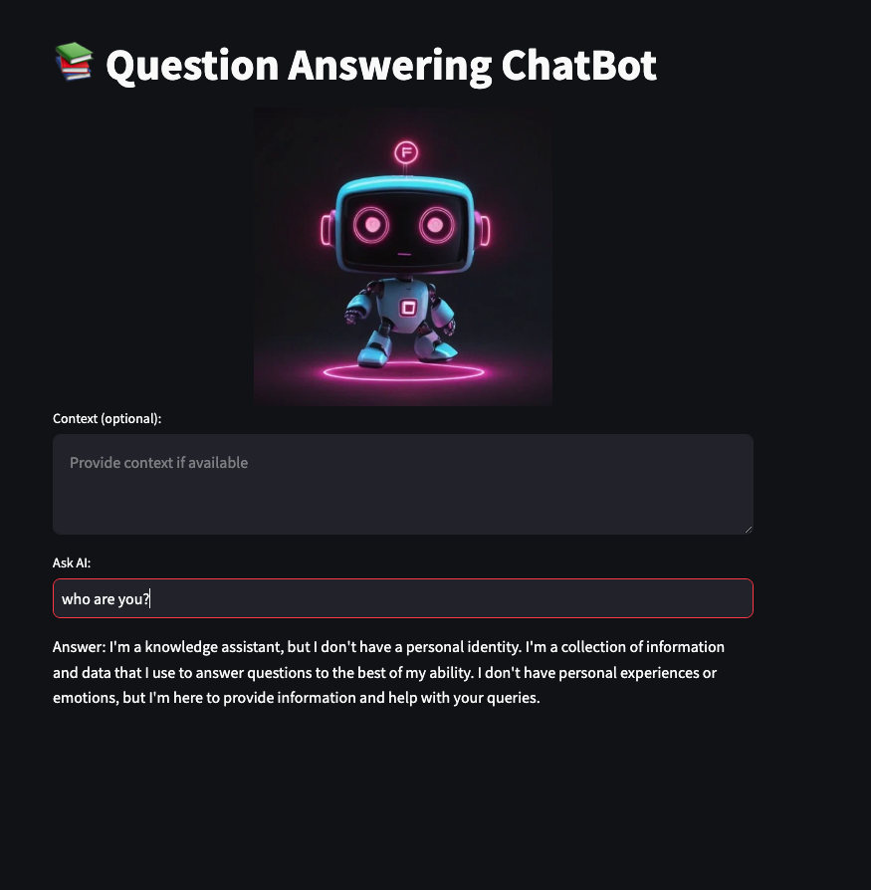
Chat Bot User Experience
Chatbot UX – Streamlit was used and UX design is shown below.

Slide 6
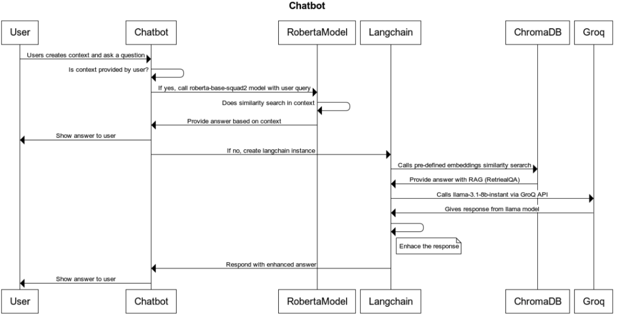
Components and Sequence diagram
The components used are
Streamlit – Web tool for UI component
Langchain – Platform tool to wok with LLMs and RAG
Chroma DB – Vector database to store the embeddings.
Hugging face – Used for Web hosting in hugging face spaces and also for embeddings
Groq – cloud hosting service of llama 3.1
Llama-3.1-8b-instant – LLM model from Meta
deepset/roberta-base-squad2 – Model tuned for question answering with squad data set 2.0 when context gets used.
Sequence Diagram

Slide 7
Chatbot Deployment
The chatbot code is deployed in Huggingface personal space. Huggingface provides a web hosting platform to provide web access to the chatbot created.
Manikandan Ramalingam’s chatbot can be publicly accessed in web using the link:-
https://manikandan18ramalingam-ai-models.hf.space

Slide 8
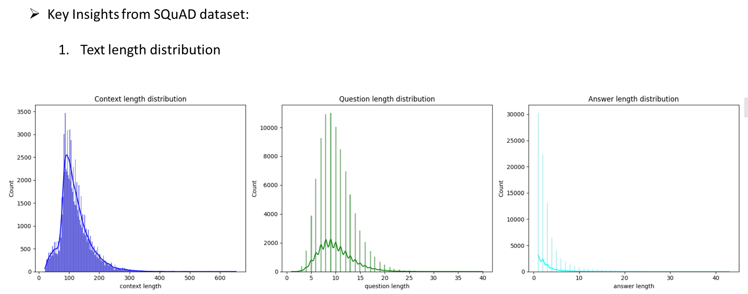
Exploratory Data Analysis

Slide 9
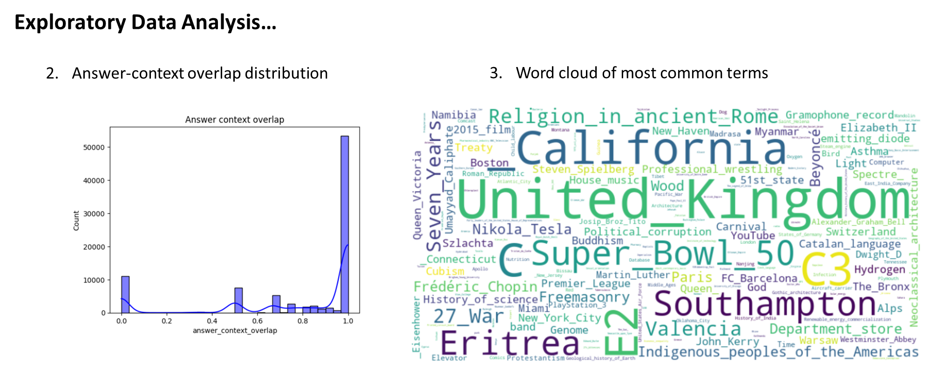

Slide 10
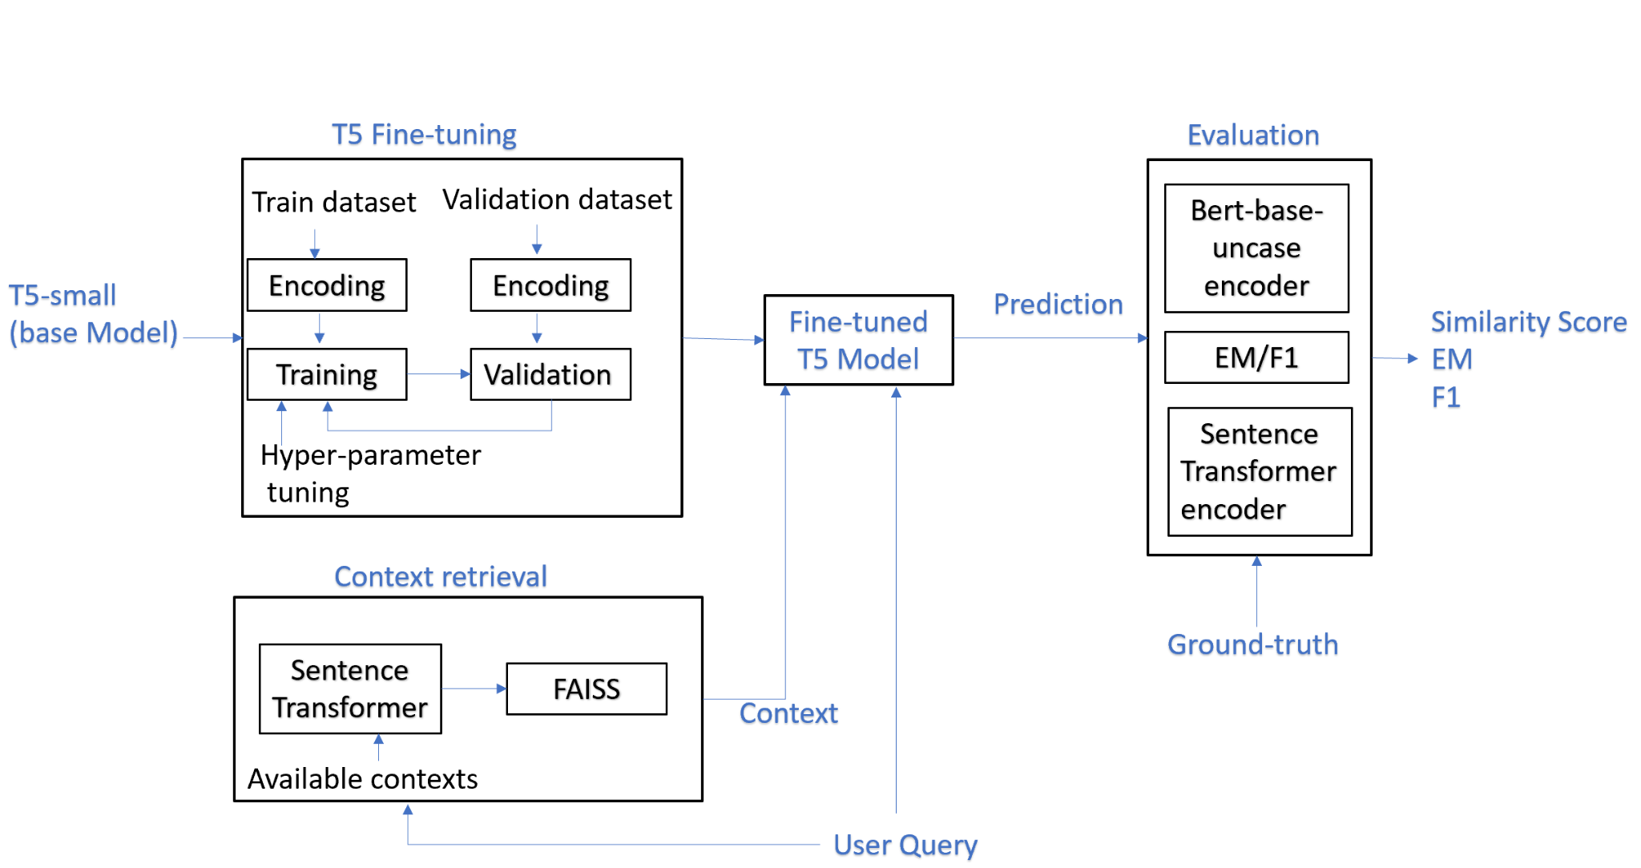

Slide 11
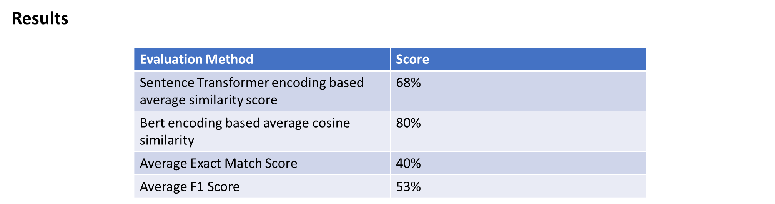

Slide 12
GPT Overview & Model Architecture
Architecture: GPT-3, a transformer-based model with multi-head attention, capable of understanding complex text and generating responses.
Key Challenge: Handling long contexts and generating concise, accurate answers.
Evaluation & Results:
Metrics: Exact Match (EM) and F1 Score.
Average EM: 80%, Average F1 Score: 84.39%.
Example Result:
Question: Who did the Virgin Mary allegedly appear to in 1858?
Generated Answer: Saint Bernadette Soubirous.
Future Improvements: Fine-tuning GPT-3 on specific datasets for enhanced accuracy.

Slide 13
Challenges & Future Improvements
Challenges:
Handling Long Contexts:
Across models (GPT-3, Roberta, Llama 3.1), managing long contexts without losing accuracy was difficult.
Memory & Computational Limitations:
Large models like Llama 70B caused crashes due to high memory demands.
Training time and resource constraints with local configurations, especially for Roberta and Llama.
Model Performance Variability:
GPT-3 and T5 struggled with some complex and nuanced queries, reducing Exact Match (EM) scores.
Embedding generation during every invocation slowed performance.
Deployment Instability:
Huggingface platform showed instability with cold starts, requiring regular pings to keep services active.
Future Improvements:
Advanced Fine-Tuning:
Further fine-tuning of models like GPT-3 and T5 on more specific datasets to increase answer accuracy and contextual understanding.
Improved Memory Management:
Implement memory-augmented models or alternative hosting solutions like Groq to handle large models efficiently.
Robust and Scalable Deployment:
Explore alternative cloud-hosting options for improved reliability and reduced downtime.
Integrate automated recovery systems to address cold start issues.
Enhanced User Experience:
Further refine the Streamlit-based interface for better user engagement and ease of use.

Slide 14
Contribution ( https://github.com/seema469/AAI_520_FinalProjectTeam6.git)
Manikandan Ramalingam | Tyler Clinscales | Seema Mittal
Implementation: Introduction Alberta squad2 and Llama3.1 LLM based chatbot Streamlit based client for Web access to Chatbot | Implementation: Conclusion GPT Fine-Tuning Implement the GPT-based chatbot model Develop and integrate a Streamlit-based client interface for web access | Implementation: EDA T5 based QA Chatbot (Final Project Chatbot Team6 T5Model.ipynb). Notebook based UI for chatbot.
Documentation: Introduction Alberta squad2 and Llama3.1 LLM based chatbot Streamlit based client for Web access to Chatbot | Documentation: Conclusion & Future Improvements GPT model section APA-7 Formatting/Review | Documentation: Abstract EDA section T5 modeling section APA- 7 formatting Document review
Presentation: Introduction Alberta squad2 and Llama3.1 LLM based chatbot Streamlit based client for Web access to Chatbot | Presentation: Conclusion & Future Improvements GPT Section Video formatting | Presentation: EDA section T5 modeling section Notebook based UI

